Slide 1
Floppy’s phonics
Stage 3 sounds

Slide 2
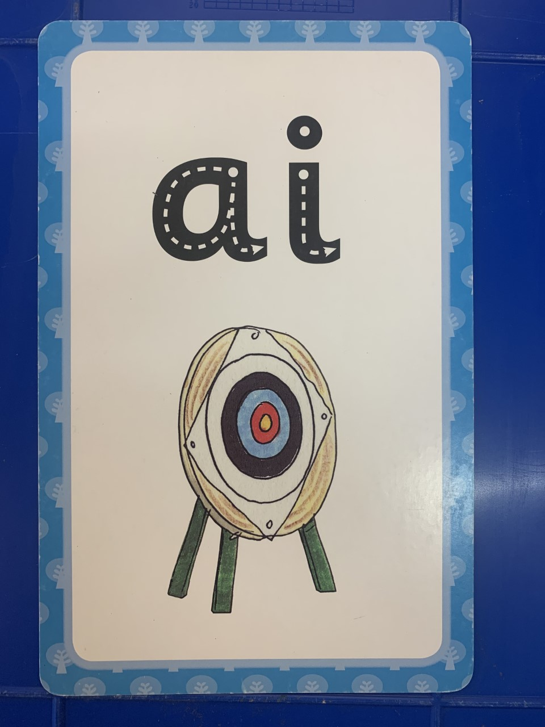

Slide 9
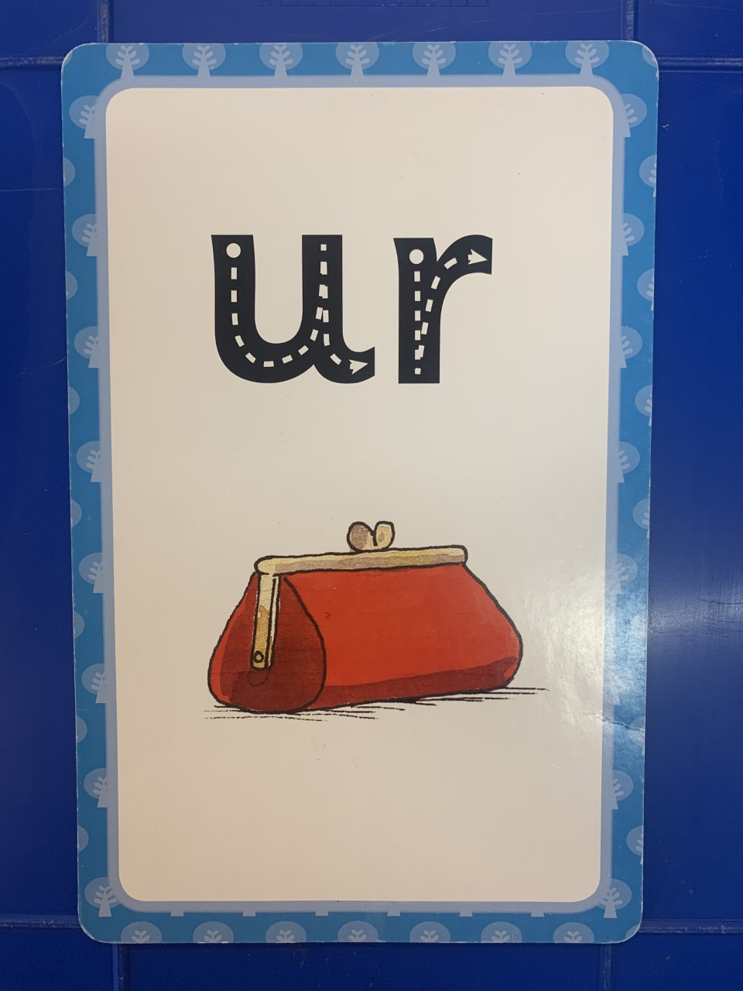

Slide 12
