Slide 1
Welcome to Year Three

Slide 2
Welcome
To give you a brief overview of the expectations/curriculum in Year 3
To give you guidance in supporting your child at home.
To answer any questions you may have about your child’s year at Allesley.

Slide 3
The Year Three Team
Mr Kates & Mrs Moran
Mrs Todd & Miss Moeller

Slide 4
Transition
We will be getting to know your children.
We have talked to their current teachers.
We spent time with them this morning.
If there is anything you think we should know; please tell us.

Slide 5
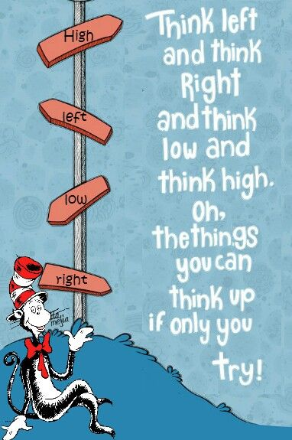
Year 3 What are we aiming for?
Happy children who want to be in school and want to learn.
Hard working children with an ‘I can’ attitude who feel good about themselves.
Children who make the academic and social progress that they are capable of.
Every child is different

Slide 6
Maths
Number bonds to 20 /100
Counting in 2s, 5s, 10s ….. 3s, 4s, 6’s and 8’s after that
Multiplication and Division facts for these tables (fact families)
Place value to 1000
Add, subtract and multiply using the column method
Fractions
Telling the time
Identify, weigh or measure quantities and amounts in the kitchen or in recipes.

Slide 7
English
Children will learn the structure of different texts through reading and writing, including stories, poetry, myths and legends, recounts and reports.
The children will continue to work on the spelling patterns and the application of the phonics they started in KS1.
Joined up handwriting.

Slide 8
Reading – It’s so important!
Books changed frequently – Please take every available opportunity to read.
Read 3x a week
Book Talk
Try to look for elements of Grammar to discuss with your child (punctuation, nouns, adjectives, verbs, types of sentences, past and present tense etc)

Slide 9
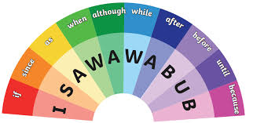
Grammar
Children this age are expected to understand the following features, to be able to spot them when reading and apply them in their writing:
Structure and language of the text
Ambitious vocabulary ( 400 new words)
Create and describe characters and settings
Paragraphs
Present and past tense
Punctuation . , ? ! " "
Conjunctions (co ordinating and subordinating)
To use a/an correctly
Spelling rules prefixes, suffixes, homophones
3 and 4 statutory words

Slide 10
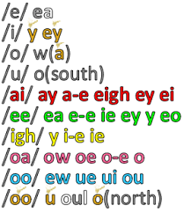
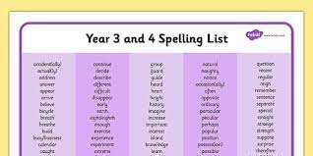
Spelling and Homework
Weekly Spelling Pattern Tested on a Monday – New spellings sent home with PALs maths homework.
Spellings on the school website
Year 3 and 4 Statutory spelling list
Times table practice
Intervention groups

Slide 11
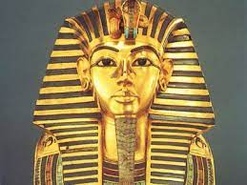
Year Three is NOT just English and Maths!
Themes – ‘Ancient Egypt’, ‘Britain through the Ages’, ‘Home and Away’.
Science – Rocks, Animals including Humans, Forces and Magnets, Plants, Light and Dark.
PSHE, RE, Computing, Art, Music, D&T and French.

Slide 12
PE & Games
Swimming – Starting Autumn Term
PE – Days to be confirmed.
Yoga – Every other week TBC.

Slide 13
Timetable
8:45 – 9:00 Early morning maths work (Children free flow straight in)
9:00 – 9:15 Spellings
9:15 – 10:25 English
10:25 – 10:40 Break
10:40 – 12:00 Maths
12:00 – 13:00 Lunch
13:00 – 13:30 Book talk
13:30 – 14:15 ICT
14:15 – 14:25 Break
14:25 – 15:10 French
15:10 – 15:25 Getting ready for home

Slide 14
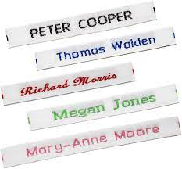
Practical things
Naming clothes
Water bottles
Reading books
Tying laces
Getting in touch with us:
See us on the playground
admin@allesley.coventry.sch.uk
Phone

Slide 15
Thanks for listening
We want your children to have a fantastic year!
Open door
Parents’ Evening
Feel free to stay and ask questions

